Slide 1



Weakly Supervised 3D Classification of Chest CT using Aggregated Multi-Resolution Deep Segmentation Features
Fakrul I. Tushar*, Anindo Saha* , Khrystyna Faryna, Vincent D'Anniballe, Rui Hou,
Geoffrey D.Rubin, Joseph Y. Lo
Department of Radiology, Duke University School of Medicine, Durham, NC;
Erasmus+ Joint Master In Medical Imaging and Application
SPIE Medical Imaging: Computer-Aided Diagnosis, Houston, TX, USA (Feb 16, 2020)

Slide 2
Overview
Introduction
Method
Results
Limitations
Conclusion
Primary Objective
— Our goal is to investigate and design a multi-organ, multi-disease classifier for CT supervised only by case-labels, using deep learning algorithms.
— In recent years, while a small number of groups are working on classifying multiple diseases in X-ray, such advancements in CT are relatively limited.
— Through the initial stage of the project, our goal is to design a multi-label
classifier to diagnose multiple diseases in chest CT.
Wang, X., Y. Peng, L. Lu, Z. Lu, M. Bagheri, R. M. Summers (2017), “ChestX-Ray8: Hospital-Scale Chest X-Ray Database and Benchmarks on Weakly-Supervised Classification and Localization of Common Thorax Diseases”, 2017 IEEE Conference on Computer Vision and Pattern Recognition (CVPR): 3462-3471.

Slide 3
Overview
Introduction
Method
Results
Limitations
Conclusion
Study Design
— Rule-based model to extract case-level labels from radiologist reports. — Case-level labelled data is used to weakly supervise a 3D classifier with multiple, simultaneous diseases occurring in chest CT. — Segmentation and classification networks are connected with two different feature aggregation strategies to enhance the classification performance.

Slide 4
Disease Label Mining
Introduction
Method
Results
Limitations
Conclusion
CT chest without contrast, Date=xxx-xx-xx, Facility=DUH Chest CT without contrast INDICATION: Shortness of breath. 786.05.TECHNIQUE: 5 mm axial images of the chest were obtained without contrast. COMPARISON: None available.
Findings: Lungs and Pleura: Lungs are clear. No pulmonary masses. Nopneumothorax. No pleural effusion. No endobronchial masses. Mediastinum and Hila: Normal heart size. No pericardial effusion. Nomediastinal or hilar adenopathy. Mild atherosclerotic disease is noted in the coronary arteries. No aneurysm. Degenerative changes are noted in the spine. Chest wall soft tissues are unremarkable.
Impression:1. No acute cardiopulmonary disease.2. Coronary artery disease.
CT chest without contrast, Date=xxxx-xx-xx, Facility=DUHProcedure: COPDgene 2 research CT protocol Indication: V70.7 Examination of participant in clinical trial, COPDGene2Research StudyCompare: August xx, xxxx
Findings: Severe emphysema. Minimal bibasal reticulation. Unchanged from prior. Multiple peri-fissural nodules, stable from prior. One calcified paracentral nodule. No significant axillary hila are or mediastinallymphadenopathy. Punctate calcification spleen. Vascular calcification.
Impression: Unchanged emphysema. Very mild interstitial lung disease.
Green- Normal Sentence
Yellow- Diseased Sentence

Slide 5
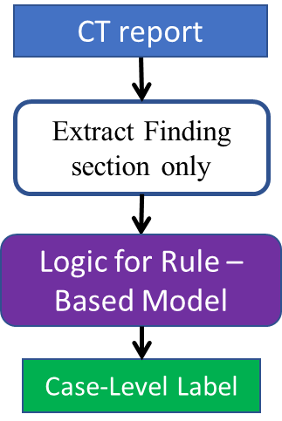
Disease Label Mining
Introduction
Method
Results
Limitations
Conclusion
Rule-Based Model
— Based on 300,000 unstructured CT radiology reports from 2012 to 2017, extracted from Duke University Health System database.
— Determines the most likely label for a given 3D CT scan, based on diagnostic keywords and terminology.
— Labels are “weak”: applied across the full volume, lacking disease localization.
Extract Findings
Section Only
Simplified working principle of the rule-based model
Faryna, K., Tushar, F.I et al. (2020), “Attention-Guided Classification of Abnormalities in Semi-Structured Computed Tomography Reports”, SPIE Medical Imaging 2020: Computer-Aided Diagnosis.

Slide 6
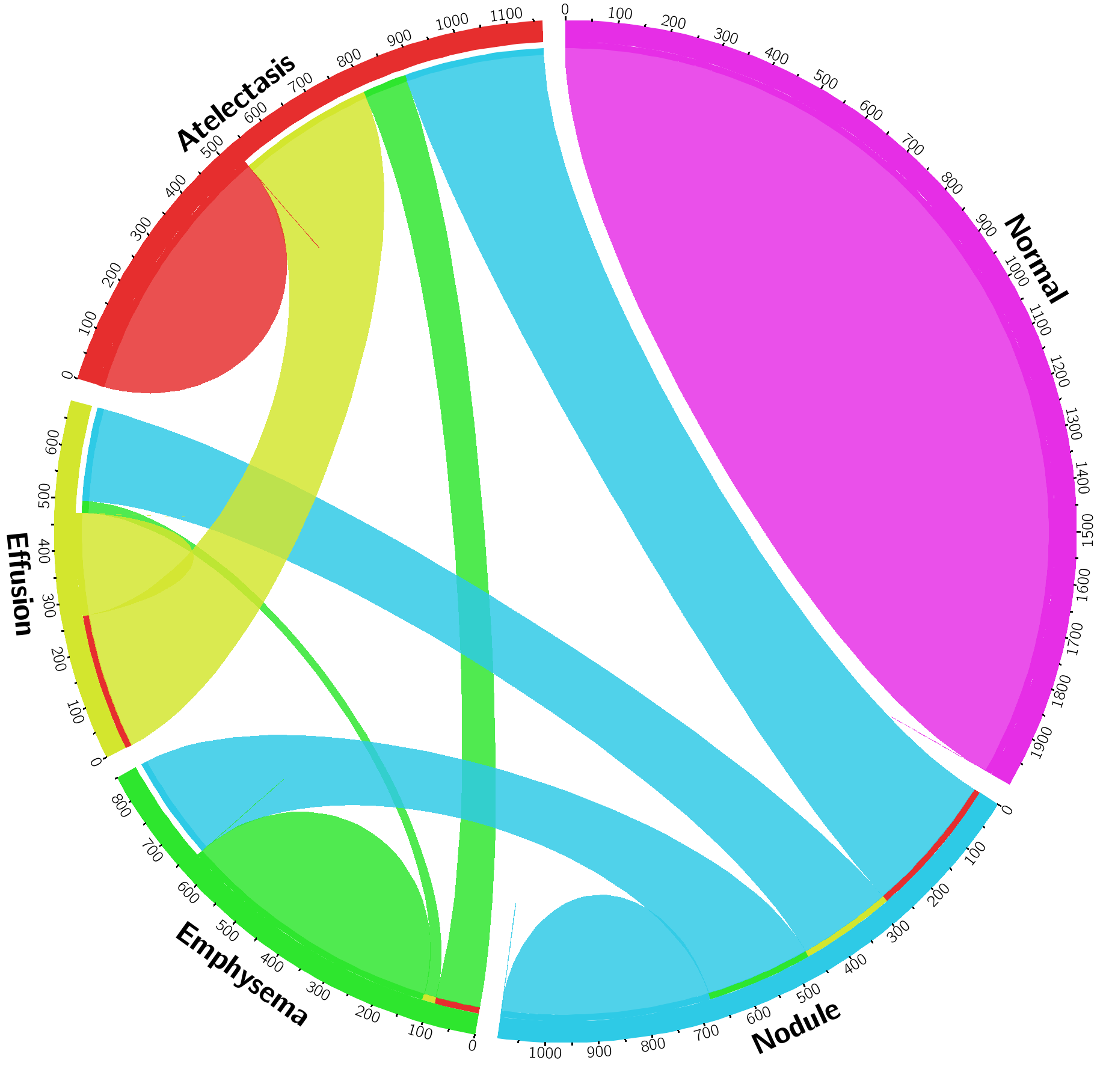
Dataset
Introduction
Method
Results
Limitations
Conclusion
Dataset for Disease Classification
Total 5471 volumes with 7233 labels
1566
CLASS | COUNT
Atelectasis (Atelectasis + Pneumonia) | 1566
Nodule (Nodule + Mass) | 1489
Emphysema | 1108
Effusion | 961
Normal | 2109
2109
961
1108
1489

Slide 7
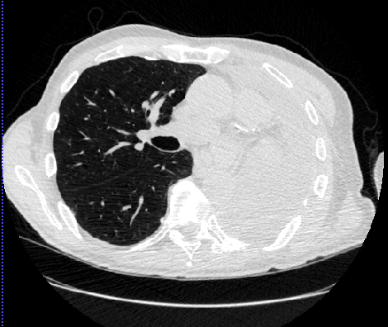
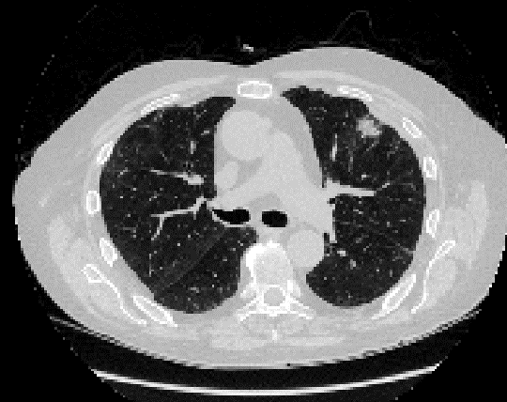
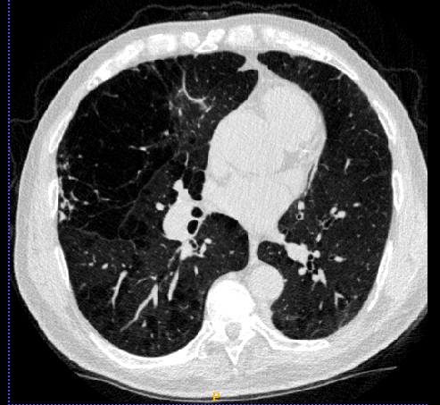
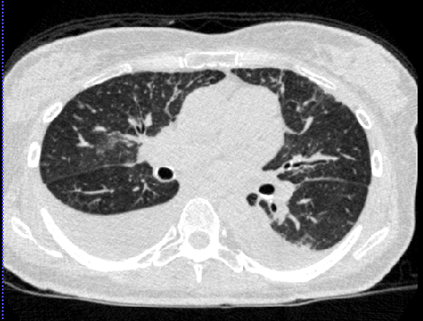
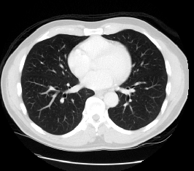
Dataset
Introduction
Method
Results
Limitations
Conclusion
Atelectasis
Nodule
Emphysema
Effusion
Normal

Slide 8
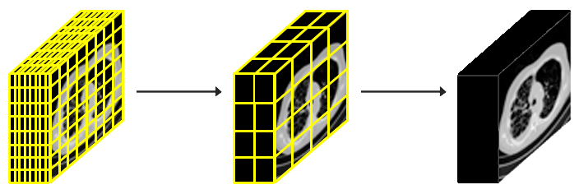
Preprocessing
Introduction
Method
Results
Limitations
Conclusion
Resampling Spatial Resolutions
Intensity Clipping, Normalization,
Whitening
Anisotropic variable high resolution scan
Isotropic medium
resolution scan: (2 x 2 x 2) mm³
Intensity distribution clipped to [-1000,800] HU, normalized to 0-1 and shifted to mean=0, std=1

Slide 9
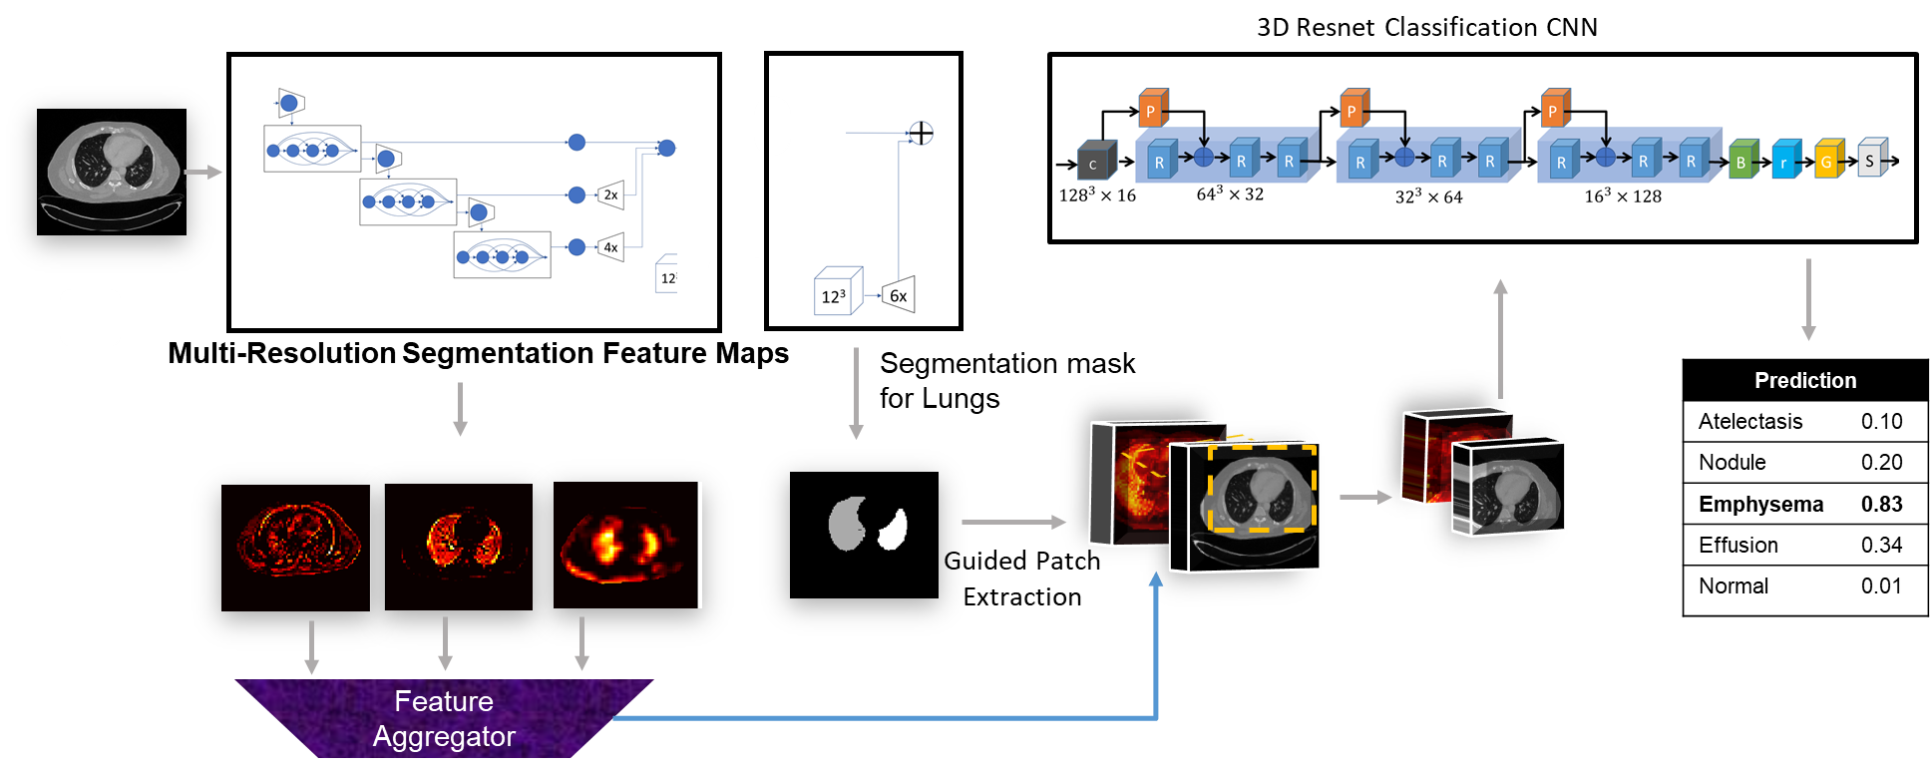
Proposed CAD
Introduction
Method
Results
Limitations
Conclusion
Feature Aggregation
Techniques
DyFA
StFA
C
1x1
Averaging
Schematic diagram of dual-stage CNN architecture for reusing segmentation feature maps in 3D binary classification. The segmentation sub-model is a DenseVNet, taking a variable input volume with a single channel and the classification sub-model is a 3D ResNet, taking an input volume patch of size [128, 128, 128] with 2 channels. Final output is a tensor with the predicted class probabilities.
StFA= Static Feature Aggregation, DyFA= Dynamic Feature Aggregation.

Slide 10
Experiments
Introduction
Method
Results
Limitations
Conclusion
Three Experiments:
Base-line Model: Classification using only CT volume.
StFA Model : Classification using StFA Strategy.
DyFA Model: Classification using DyFA Strategy.
— Adam Optimizer
— Weighted Cross-Entropy loss

Slide 11
Results
Introduction
Method
Results
Limitations
Conclusion

Slide 12
Limitation & Conclusion
Introduction
Method
Results
Limitations
Conclusion
— “Weak” labels, without disease localization: even a positive scan can hold hundreds to thousands of negative slices along multiple planes.
— Using downsampled, lower resolution data due to computational complexity.
— Effect of deep segmentation features with respect to the size of the dataset for CT data, remains to be investigated.
— Need to Independent hyperparameter optimization for each model, followed by rigorous statistical analysis, to draw out a full comparative analysis.
Wong, K.C. et al. (2018), “Building Medical Image Classifiers with Very Limited Data using Segmentation Networks”, Elsevier Medical Image Analysis.

Slide 13
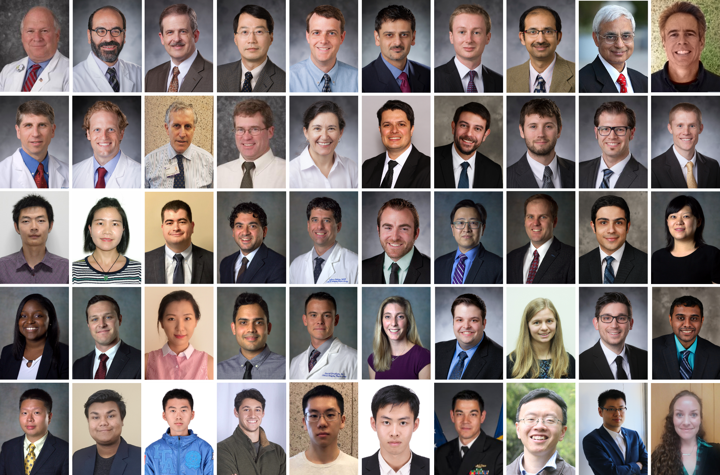
Thank you! [fakrulislam.tushar@duke.edu]

